Slide 1

Data Mining HT26 (4DV510/4DT910), 5hp
Introduction, 1.9.2026

Slide 2
Welcome!
Today:
About the course
  Teachers
  Prerequisites, Examination
  Projects
Brief introduction to Data Mining

Slide 3
Teachers and Staff
Sebastian Hönel: Course Responsible, Teacher
Alisa Lincke: Teacher
Claudio Linhares: Examinator
Parisa Salmanian: Teaching Assistant (tutorial sessions)
Communication:
For questions and discussions about the course, we recommend you use the Moodle forums. Does everybody have access? No? Please come forward!
Questions and help for the project: Contact Parisa first and come to the tutorials!
All submissions are done via Moodle exclusively.
Notes:
Prepare yourself well for the tutorials so that we can help efficiently.

Slide 4
Literature
Mining of Massive Datasets (MMDS) by Leskovec, Rajaraman, and Ullman; http://www.mmds.org/
Introduction to Data Mining, 2nd ed., Pearson, 2020 by Tan, P.-N., Steinbach, M., Karpatne, A., & Kumar, V.; https://www-users.cse.umn.edu/~kumar001/dmbook/index.php
An Introduction to Statistical Learning (ISLR) by James, Witten, Hastie, and Tibshirani; https://web.stanford.edu/~hastie/ISLRv2_website.pdf

Slide 5
Main Activities
1 Introduction + 3 + 4 Lectures (7 themes; Tuesdays)
A project that involves 4 themes of your choice. Groups of 3.
An intermediate presentation of your project after lecture 4.
  Week 39 on September 22nd.
1 + 6 Tutorial sessions
  You need to present your project idea during the first one.
Final presentation in week 44 (October 27th).

Slide 6
Examination
Note that 4DV510 and 4DT910 have different examination forms.
However, to give one coherent course, we would like to examine by the rules of 4DV510 only. See next slide.
Any objections?
4DV510 / 5hp | 4DT910 / 5hp
Written exam, 3hp Programming project, 2hp | Oral exam, 1hp Programming project, 2hp Programming assignments, 1hp Reflection report, 1hp

Slide 7
Examination (cont’d)
The written exam accounts for 60% of your grade (4DV510).
The oral exam accounts for 20% of your grade (4DT910).
For 4DT910, you will have to additionally hand in 2 assignments (20%) and an extended, individual reflection report (20%). The report should be between 2-4 pages and cover your lessons learned, your individual contributions, what key choices you made, how trustworthy and valid the obtained results are, etc. (see Moodle).
The project accounts for 40% of your grade.
You need to obtain a passing-grade (>=60%) for each moment individually, to pass the course.
Re-take policy:
There is one re-take each for the exam and each presentation.
Late submissions count as fail – no exceptions, no extensions.
Prerequisites:
4DV660 (or equivalent)
English 6/B (or equivalent)
Notes:
What courses in ML did you take so far, what are your experiences?

Slide 8
The Project
You need to conduct a data mining project (in Python) over the duration of the course. It accounts for 40% of your grade.
  You will have an intermediate presentation after four lectures.
  After the final presentation, you need to submit your (working!) code and a project report (1-2p).
You are working in groups of 3.
During the first tutorial session, you have to propose a project and tell us who is in your group.
On Moodle, the Project Master Document outlines everything you need to know!
  The course has seven themes, your project needs to cover four.
Notes:
The 7 themes are:
Data Handling
Outlier Detection
Association Rule Mining
Clustering
Dimensionality Reduction
Networks
Text Mining

Slide 9
Learning Outcomes
After completion of the course, students will be able to:
Explain fundamental data-mining concepts and principles, including distance measures, dimensionality reduction, and clustering.
Describe current developments, techniques, and applications in data mining.
Design and plan a data-mining pipeline for a given dataset or data stream, selecting suitable methods and assessing expected output quality.
Implement efficiently selected foundational algorithms, such as Multidimensional Scaling (MDS) and DBSCAN clustering.
Apply appropriate existing tools and software libraries to extract insights from structured or unstructured datasets and data streams.

Slide 10
Next Steps
You need to divide yourselves into groups of 3.
You need to produce a project proposal and a small presentation of it (5 mins max., because we need to be able to give you feedback).
This proposal is to be presented during the first tutorial session (mandatory) on September 10th.
You need to incorporate our feedback and submit that proposal that same day.
You will get feedback from us latest the next day. Don’t start before!

Slide 11
Thank you!
Any questions?
(otherwise, we’ll proceed with the introduction...)

Slide 12
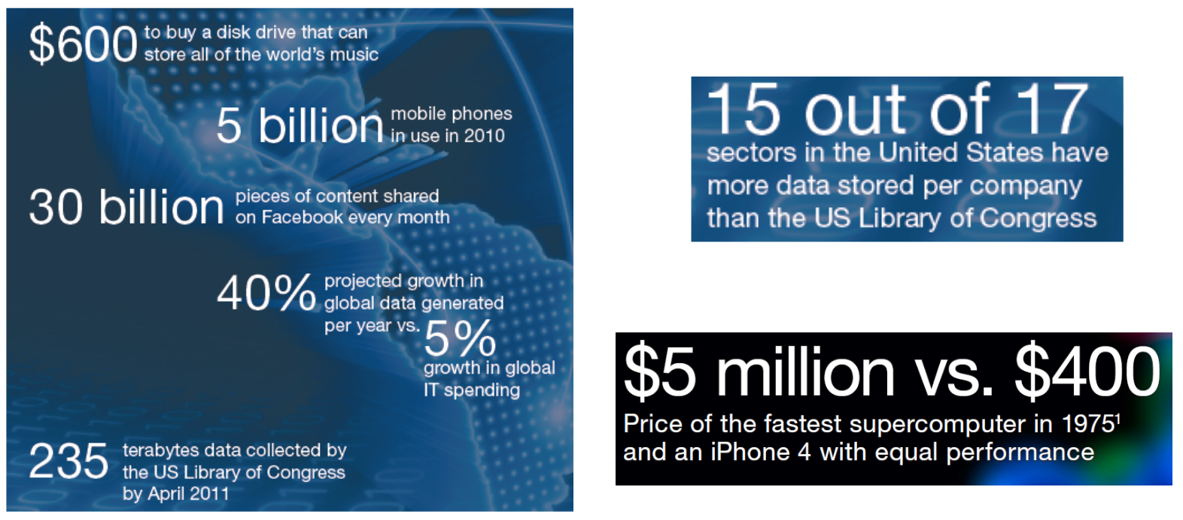
Introduction – What is Data Mining?
Every day, an enormous amount of data is produced.
How to make good use of it? Often the answers are:
Machine learning
Statistical modelling
Slides based on material by
Leskovec, Rajaraman, and Ullman;
http://www.mmds.org
Notes:
The default answers do not fully apply in this course, we’ll do something else predominantly.

Slide 13
What is Data Mining?
It is the process of extracting and finding patterns in massive data sets involving methods at the intersection of machine learning, statistics, and database systems [1].
Involved paradigms are, for example: Pre-processing, Unsupervised learning, Pattern extraction, Visual analytics, Knowledge discovery, and more.
[1] Data Mining Curriculum: A Proposal. SIGKDD, 2013, ACM.

Slide 14
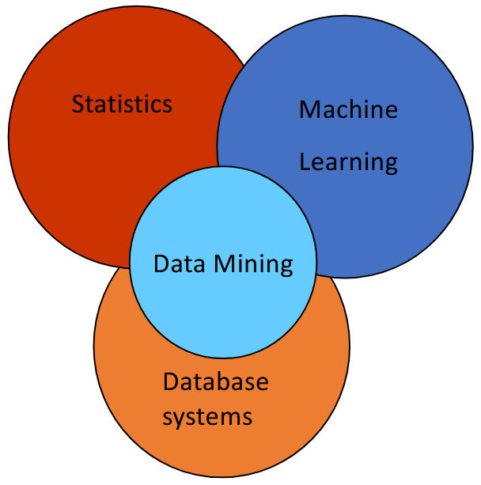
What is Data Mining?
It is very hard to define data mining in
objective terms.
For the purposes of this course, it is NOT Supervised Machine Learning.
It is also not purely statistical modeling, although there might be some of it.
In general, we will think of data mining more as an algorithmical process rather than a mathematical or formal one.
How many of you have taken an ML course before?
Notes:
We will do ML-related things, just not supervised ML.
Explain what supervised ML is and ask students about unsupervised ML. Then explain unsupervised ML, as well as what inductive bias is: “The IB of a learning algorithm is the set of assumptions that the learner uses to predict outputs of given inputs that it has not encountered.”
We will study and implement algorithms/techniques to extract patterns from data without having labels.

Slide 15
What is Data Mining?
The six common tasks are:
Anomaly (outlier/change/novelty/deviation) detection
Association rule learning (dependency modeling)
Clustering (groups and structure)
Classification
Regression (least-error modeling)
Summarization (compact representations; visualization, etc.)
In this course, we will also do:
Data handling
Dimensionality reduction
Networks
Text Mining

Slide 16
What is Data Mining?
Descriptive methods: Find human-interpretable patterns that describe the data
Example: Clustering
Predictive methods: Use some variables to predict unknown or future values of other variables
Example: Recommender systems
Notes:
Descriptive methods: A very important part that is different from traditional ML. A recent trend that goes towards that is explainable AI. For data mining, “human-interpretable” is fundamental.
Predictive methods: Without having labels, we will try to understand what are the underlying patterns in the data of value to us.

Slide 17
What is Data Mining?
Machine Learning works better when…
There are no underlying assumptions about the structure of the data and what parts of this structure will contribute to the solution.
You don’t need to understand the solution, as long as it works.
You have a specific objective cost function that serves as the goal of the learning process.
Notes:
What’s the difference between Data Mining and ML; why should we study it?
Example: Learning using an NN – we don’t know or care about the structure of our data. In fact, we want to encourage the model to find a useful latent representation w.r.t. our task (e.g., classifying dogs vs. cats). Instead of feature engineering, we do representation learning.
This directly connects to the last point. We usually do not have such a function. Data Mining, instead, is more of an explorative process for finding interesting patterns.

Slide 18
What is Data Mining?
We encourage you to think of data mining in general as a set of tools and techniques for extracting (hopefully) useful patterns from large datasets.
This is an intentionally broad and open definition, since the course is mainly centered around a loosely-coupled collection of techniques that may or may not be applicable in different scenarios.
Notes:
The definition, as you see, is not strict. And that’s how this course is going to be, too.
Every lecture is its own theme where we focus on a specific theme in data mining.
Note there is not necessarily a connection between these themes.

Slide 19
What is Data Mining?
In other words…
Given lots of data, discover patterns and models that are:
  Valid: they should hold on new data with some certainty
  Useful: should be possible to act on the item
  Unexpected: non-obvious to the system
  Understandable: humans should be able to interpret the pattern
Notes:
Validity means also generalizability.
Usefulness: For example, support decision-making or further exploration.
Unexpected: In other words, non-trivial.

Slide 20
What is Data Mining?
Simple example: consider that you have gathered a set of data points (numerical measurements), and you assume that the data comes from a Gaussian distribution.
One way to analyze this data would be to create a model by extracting the mean and standard deviation that best describe the original distribution from which the data was sampled.
No external labels to validate your hypothesis
If your hypothesis is wrong, then your model is wrong.
No specific, objective use for the information you extracted; it is simply new knowledge
You have summarized your data set with two numbers (or: you mined the two parameters from your dataset).
Notes:
This connects to what we said earlier about inductive bias. This example here is, albeit being very simple, a prime example for data mining.
Our assumption here is the inductive/learning bias.
As you see, one goal is that the mined patterns/knowledge is easier to understand than the actual data. Mining a million parameters from a million datapoints would be useless.

Slide 21
What is Data Mining?
Summarization is one of the main applications of data mining. One other common example of summarization is clustering: we (again) assume that there are groups of similar elements in the data set, and that finding such groups will be useful to us.
Notice that many dataset have no such clear groups, but clustering algorithms will find them anyway.
Notes:
Separating the datasets into cohesive groups.
When applying clustering, there is, again, an assumption (inductive bias) that such groups exist.

Slide 22
What is Data Mining?
One other common application of data mining is feature extraction, or the search for salient structure in otherwise unstructured (or too complex) data.
For example: given a certain element of your data set (such as a query by example), you might be interested in finding other similar elements (e.g., nearest neighbors).
For this, you need to think in terms of similarity between arbitrary elements.
Notes:
For example, we need to think about (kinds of) distances.
For example, what about Euclidean distance? In high dimensions, it does not work well.

Slide 23
End of First Lecture
Any questions?

